Slide 1


Nitisha Nikhare
30th May 2025

Slide 2

Outline
Executive Summary
Introduction
Methodology
Results
Conclusion
Appendix

Slide 3
Executive Summary
Executive Summary Slide 1: Summary of Methodologies
Data Collection: Acquired dataset from SpaceX API, containing multiple number of samples and features relevant to the classification task.
Data Wrangling: Performed data cleaning (missing values, duplicates), feature selection, and standardized features using StandardScaler.
Exploratory Data Analysis (EDA): Used statistical summaries, visualizations (histograms, boxplots, scatterplots), and SQL queries to understand data distribution and feature relationships.
Interactive Visual Analytics: Built Folium maps for spatial data visualization and Plotly Dash dashboards to interactively explore insights.
Predictive Modeling: Developed multiple classification models including Logistic Regression, Support Vector Machines (SVM), Decision Trees, and K-Nearest Neighbors (KNN).
Hyperparameter Tuning: Employed GridSearchCV with 10-fold cross-validation to optimize model parameters and prevent overfitting.
Model Evaluation: Split data into training and test sets, assessed models via accuracy and confusion matrices.

Slide 4
Executive Summary
Executive Summary Slide 2: Summary of Results
Model Performance:
Support Vector Machine (SVM) achieved the highest validation accuracy with optimal kernel and parameters.
Logistic Regression provided a strong baseline with interpretable coefficients.
Decision Tree and KNN models performed moderately well after tuning.
Confusion Matrix Insights:
False positives were the primary source of classification errors, especially in Logistic Regression.
True positives were significantly higher in optimized models, confirming their predictive capability.
Visualization Outcomes:
EDA visualizations highlighted key feature differences across classes.
SQL queries confirmed class distributions and feature statistics.
Folium maps revealed spatial patterns, supporting deeper data understanding.
Plotly Dash dashboards enabled dynamic interaction with data and model results.
Overall Conclusion:
The project successfully identified effective classification models and visualized critical data insights, laying groundwork for further improvements.

Slide 5
Introduction
Project Background and Context:
The project focuses on analyzing a dataset to classify observations accurately into different classes using machine learning.
Classification models like Logistic Regression, Support Vector Machines, Decision Trees, and K-Nearest Neighbors are applied to identify patterns and make predictions.
Data science workflow includes data collection, cleaning, exploratory analysis, visualization, modeling, and evaluation to gain actionable insights.
Understanding the factors influencing classification helps improve decision-making in the relevant domain (e.g., healthcare, marketing, finance).
Problems to Find Answers:
Which features in the dataset are most influential for predicting the class labels?
How well can different machine learning models classify the data?
What are the best hyperparameters for each model to maximize accuracy?
What types of errors (false positives, false negatives) do the models produce, and how can they be minimized?
Can interactive visualizations provide deeper insight into data patterns and model performance?

Slide 6

Section 1

Slide 7
Methodology
Executive Summary
Data Collection: Collected the data using SpaceX API, containing relevant features and target labels for classification.
Data Wrangling: Cleaned data by handling missing values, removing duplicates, and selecting important features. Standardized numerical features for consistency.
Data Processing: Transformed raw data into model-ready format, including normalization and encoding categorical variables as needed.
Exploratory Data Analysis (EDA): Used visualizations (histograms, scatter plots, box plots) and SQL queries to analyze data distributions, correlations, and class imbalances.
Interactive Visual Analytics: Developed interactive geographic visualizations with Folium and dynamic dashboards with Plotly Dash to explore patterns and trends.
Predictive Analysis: Built classification models — Logistic Regression, Support Vector Machines, Decision Trees, and K-Nearest Neighbors.
Model Building, Tuning, and Evaluation: Applied GridSearchCV with cross-validation to find optimal hyperparameters. Evaluated models using accuracy scores and confusion matrices on test data.

Slide 8
Data Collection
The dataset was collected by querying the official SpaceX API, which provides comprehensive and up-to-date information on SpaceX launches, rockets, payloads, and related mission data.
Step-by-Step Data Collection Flow:
Identify Data Requirements
Define the target variables (e.g., launch success/failure) and relevant features (e.g., launch date, rocket type, payload mass).
Access SpaceX API Endpoint
Connect to the RESTful SpaceX API endpoint (https://api.spacexdata.com/v4/launches) using HTTP requests.
Authenticate if necessary (SpaceX API is public, so no key required).
Send API Requests
Use Python libraries like requests or http.client to send GET requests.
Retrieve JSON formatted data containing detailed launch records.
Extract Relevant Data Fields
Parse JSON responses to select necessary attributes (e.g., mission name, date, rocket specifications, launch success status).
Handle Pagination and Data Limits
For large datasets, manage API pagination or batching to collect all records efficiently.
Store Raw Data Locally
Save retrieved data into structured formats such as CSV or JSON files for offline processing.
Verify Data Completeness and Integrity
Check for missing or inconsistent entries and document data quality issues.

Slide 9
Data Collection
Key Phrases for Presentation and Flowchart
Define objectives & select variables
Connect to SpaceX API endpoint
Send HTTP GET requests
Retrieve & parse JSON data
Extract required fields
Manage pagination for large data
Store data locally (CSV/JSON)
Verify data completeness & quality

Slide 10
Data Collection – SpaceX API
Key Phrases (You can bullet these in your slide):
REST API Integration
SpaceX API v4 Endpoint
HTTP GET Requests using Python
JSON Response Parsing
Payload, Launch, Rocket, and Core Data
Data Normalization and Structuring
CSV File Export for Further Analysis
Validation of Retrieved Data
The GitHub URL of the completed SpaceX API calls notebook : https://github.com/nitisha3135/Applied_Data_Science_Capstone_Project/blob/main/Lab-01-jupyter-labs-spacex-data-collection-api.ipynb
Define Data Requirements
↓
Connect to SpaceX API
↓
Send HTTP GET Requests
↓
Receive JSON Response
↓
Parse and Extract Fields (launchpad, rocket, payload, outcome, etc.)
↓
Normalize & Clean the Data
↓
Save Structured Data Locally (CSV/JSON)
↓
Validate for Completeness and Accuracy

Slide 11
Data Collection - Scraping
Key Phrases For Web Scraping:
Identify Target Webpage
Inspect HTML structure with Developer Tools
Use request to Fetch Web Content
Parse HTML with BeautifulSoup
Locate and Extract Data Tags
Clean and Normalize Extracted Data
Merge with API Data (if required)
Save Final Dataset for EDA and Modeling
The GitHub URL of the completed Web Scraping notebook : https://github.com/nitisha3135/Applied_Data_Science_Capstone_Project/blob/main/Lab-02-jupyter-labs-webscraping.ipynb
Identify Web Page to Scrape
↓
Inspect HTML Structure (Elements, Classes, IDs)
↓
Send HTTP GET Request (Using `requests`)
↓
Parse HTML Content with BeautifulSoup
↓
Locate and Extract Relevant Tags (e.g., <table>, <td>, <span>)
↓
Clean and Structure Data into DataFrame
↓
Merge with API Dataset (optional)
↓
Export to CSV or Continue with Analysis

Slide 12
Data Wrangling
Key Phrases for Data Wrangling:
Data Cleaning
Handling Missing and Null Values
Type Conversion and Normalization
Merging DataFrames from Multiple Sources
Removing Duplicates
Extracting New Columns (e.g., Year from Date)
Feature Engineering
Exporting Cleaned Data to CSV
The GitHub URL of the completed Data Wrangling notebook : https://github.com/nitisha3135/Applied_Data_Science_Capstone_Project/blob/main/Lab-03-labs-jupyter-spacex-Data%20wrangling.ipynb
Import Raw Data (from API & Web Scraping)
↓
Inspect DataFrames for Shape and Types
↓
Handle Missing Values and NaNs
↓
Normalize Nested Columns (e.g., payloads, cores)
↓
Convert Data Types (Dates, Booleans, Floats)
↓
Merge API and Scraped DataFrames
↓
Remove Duplicates and Irrelevant Columns
↓
Create New Features (e.g., Mission Success Flag)
↓
Export Cleaned Dataset to CSV

Slide 13
EDA with Data Visualization
To explore data, scatterplots and barplots were used to visualize the relationship between pair of features:
Payload Mass vs. Flight Number
Launch Site vs. Flight Number
Launch Site vs. Payload Mass
Orbit vs. Flight Number
Payload Mass vs. Orbit
The GitHub URL of the completed EDA with Data Visualization notebook :
https://github.com/nitisha3135/Applied_Data_Science_Capstone_Project/blob/main/Lab-05-edadataviz.ipynb

Slide 14
EDA with SQL
Summary of SQL Queries Performed:
The names of the unique launch sites in the space mission
Top 5 records where launch sites begin with the string 'CCA’
The total payload mass carried by boosters launched by NASA (CRS)
Average payload mass carried by booster version F9 v1.1;
Date when the first successful landing outcome in ground pad was achieved;
Names of the boosters which have success in drone ship and have payload mass between 4000 and 6000 kg;
Total number of successful and failure mission outcomes;
Names of the booster versions which have carried the maximum payload mass;
Failed landing outcomes in drone ship, their booster versions, and launch site names for in year 2015; and
Rank of the count of landing outcomes (such as Failure (drone ship) or Success (ground pad)) between the date 2010-06-04 and 2017-03-20.
The GitHub URL of the completed EDA with SQL notebook : https://github.com/nitisha3135/Applied_Data_Science_Capstone_Project/blob/main/Lab-04-jupyter-labs-eda-sql-coursera_sqllite.ipynb

Slide 15
Build an Interactive Map with Folium
Map Objects Created and Added:
folium.Map:
What: The base map object, centered around a specific coordinate (initially NASA Johnson Space Center).
Why: To provide the geographical context upon which all other elements are overlaid.
folium.Circle:
What: Circles centered at each launch site coordinate.
Why: To visually mark the locations of the different launch sites on the map.
folium.Marker (with DivIcon) for Launch Sites:
What: Markers placed at each launch site coordinate, displaying the name of the launch site as a text label.
Why: To clearly identify each launch site by name on the map.
folium.plugins.MarkerCluster:
What: A layer that groups multiple markers together at higher zoom levels, decluttering the map when many launch outcomes are near each other.
Why: To handle the potentially large number of individual launch outcome markers, making the map more readab.
5.folium.Marker (with folium.Icon) for Launch Outcomes:
What: Markers placed at each launch's coordinates, colored green for success and red for failure.
Why: To visually distinguish successful and failed launches at each site, providing insight into the success rates at different locations.

Slide 16
Build an Interactive Map with Folium
6.folium.plugins.MousePosition:
What: A control added to the map that displays the latitude and longitude of the mouse cursor as it moves over the map.
Why: To allow the user to easily identify coordinates on the map, which is helpful for finding the locations of nearby features (coastline, railways, highways, cities).
7.folium.Marker (with DivIcon) for Proximity Distances:
What: Markers placed at the approximate locations of the closest coastline, railway, highway, and city to each launch site, displaying the calculated distance.
Why: To quantify and visualize how close each launch site is to these important geographical features.
8.folium.PolyLine:
What: Lines drawn connecting each launch site to the markers representing the closest coastline, railway, highway, and city.
Why: To visually link each launch site with its nearest proximities, making it easier to understand the distances and spatial relationships.
The GitHub URL of the Interactive Map with Folium notebook : https://github.com/nitisha3135/Applied_Data_Science_Capstone_Project/blob/main/Lab-06-lab_jupyter_launch_site_location.jupyterlite.ipynb

Slide 17
Build a Dashboard with Plotly Dash
Various graphs and plots were utilized to effectively visualize the data and uncover insightful patterns.
A pie chart was used to display the percentage of launches by site, giving a clear understanding of the distribution of launch activities across different SpaceX sites.
A histogram or density plot showcased the range and distribution of payload masses, allowing quick identification of common payload capacities.
The combination of these visualizations made it easier to analyze the relationship between launch sites and payload ranges, helping determine the most suitable launch site based on the payload mass.
This approach provided valuable insights for optimizing future launches by aligning payload requirements with the capabilities of specific launch sites.
The GitHub URL of the Dashboard with Plotly Dash notebook : https://github.com/nitisha3135/Applied_Data_Science_Capstone_Project/blob/main/Lab-07-spacex-dash-app.py

Slide 18
Predictive Analysis (Classification)
How We Built, Evaluated, and Tuned Models:
1. Data Preparation
Target variable: class (Launch success: 0 = Fail, 1 = Success)
Features: Encoded categorical variables and standardized numerical features
Split dataset into training and testing sets using train_test_split()
2. Models Trained
Logistic Regression
Support Vector Machine (SVM)
Decision Tree
K-Nearest Neighbors (KNN)
3. Hyperparameter Tuning with GridSearchCV
Performed cross-validation with cv=10
Tuned model parameters like: • Logistic Regression: C, penalty, solver • SVM: kernel, C, gamma • Decision Tree: criterion, splitter, max_depth, etc. • KNN: n_neighbors, algorithm, p

Slide 19
Predictive Analysis (Classification)
4. Model Evaluation Metrics
Accuracy scores
Confusion matrix (true positives, false positives)
Test data evaluation using .score()
5. Best Performing Model
Based on test set accuracy: Support Vector Machine (SVM) with the rbf kernel gave the highest accuracy
6. Improvements
Standardized features using StandardScaler
Applied proper hyperparameter tuning
Evaluated using test data to avoid overfitting
Data Collection → Feature Engineering → Data Split (Train/Test)
↓ ↓
Hyperparameter Tuning with GridSearchCV
↓
Model Evaluation (Accuracy, Confusion Matrix)
↓
Model Selection
The GitHub URL of the Predictive Analysis notebook : https://github.com/nitisha3135/Applied_Data_Science_Capstone_Project/blob/main/Lab-08-SpaceX_Machine%20Learning%20Prediction_Part_5.ipynb

Slide 20
Results
Exploratory Data Analysis Results:
SpaceX conducted launches from four distinct launch sites, each contributing to the mission volume.
The initial launches were primarily for NASA and SpaceX’s internal missions, marking the beginning of their commercial space endeavors.
The average payload carried by the Falcon 9 v1.1 booster was calculated to be 2,928 kg, serving as a baseline for performance comparisons.
The first successful landing of a booster occurred in 2015, nearly five years after the inaugural launch, signifying a major milestone in reusability.
Several versions of the Falcon 9 boosters achieved successful landings on drone ships, particularly those carrying payloads above the average, demonstrating improved reliability over time.
Mission success rates were exceptionally high, with nearly 100% of launches achieving their intended objectives.
In 2015, two booster versions—F9 v1.1 B1012 and F9 v1.1 B1015—failed to land on drone ships, highlighting key challenges in the early stages of reusability.
The frequency of successful landing outcomes improved steadily year over year, indicating significant advancements in landing technology and booster control systems.

Slide 21
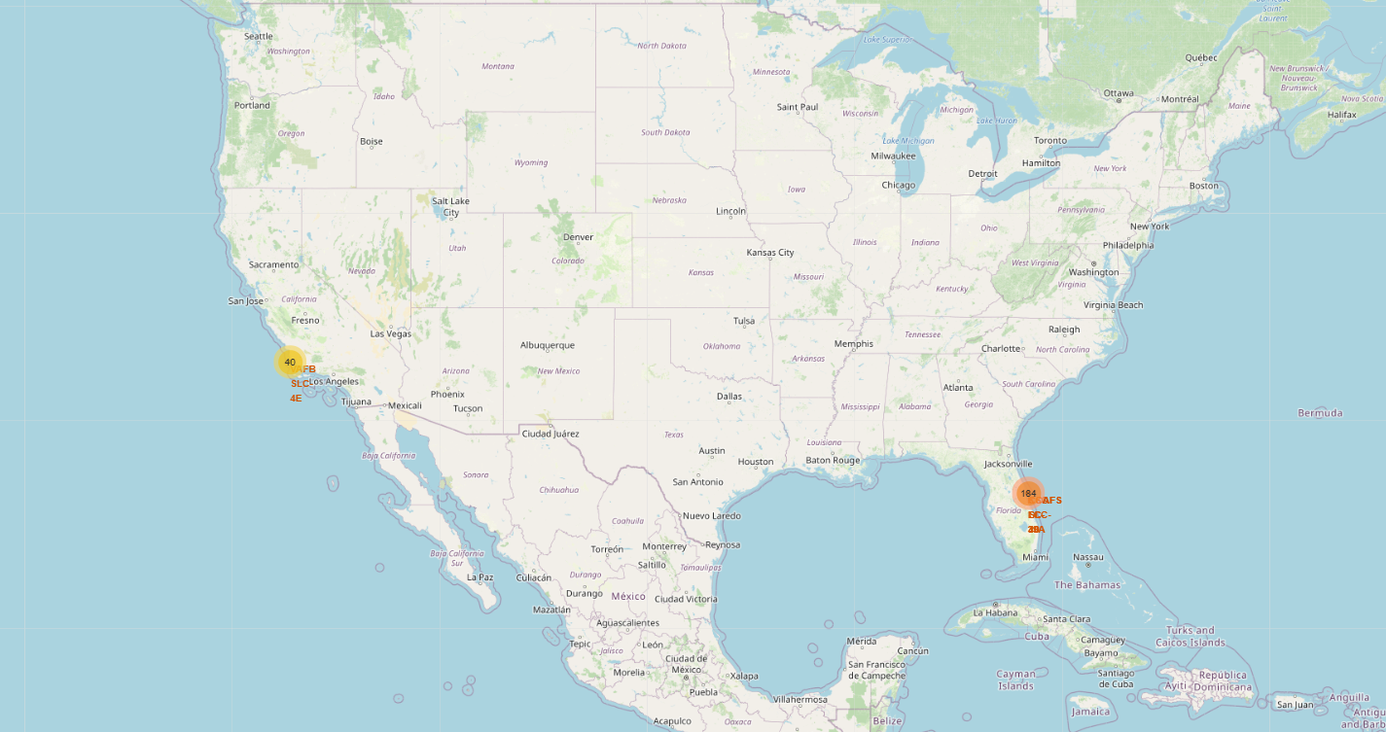
Results
Interactive analytics demo in screenshots:
Summary of insights deriven from interactive analysis of the maps:
Safety and Location: Launch sites tend to be in relatively unpopulated areas, often near the sea. This coastal proximity offers safety advantages (launch trajectory over water) and potentially logistical benefits for transporting large rocket stages by sea.
Logistics: The presence of good infrastructure around launch sites (as seen with distances to highways and railways) is crucial for the movement of equipment, personnel, and payloads.
East Coast Dominance: The observation that most launches happen at East Coast launch sites (like Cape Canaveral/KSC) is significant and could be related to historical factors, orbital inclinations favored by eastward launches, or the concentration of space-related industries in that region.

Slide 22
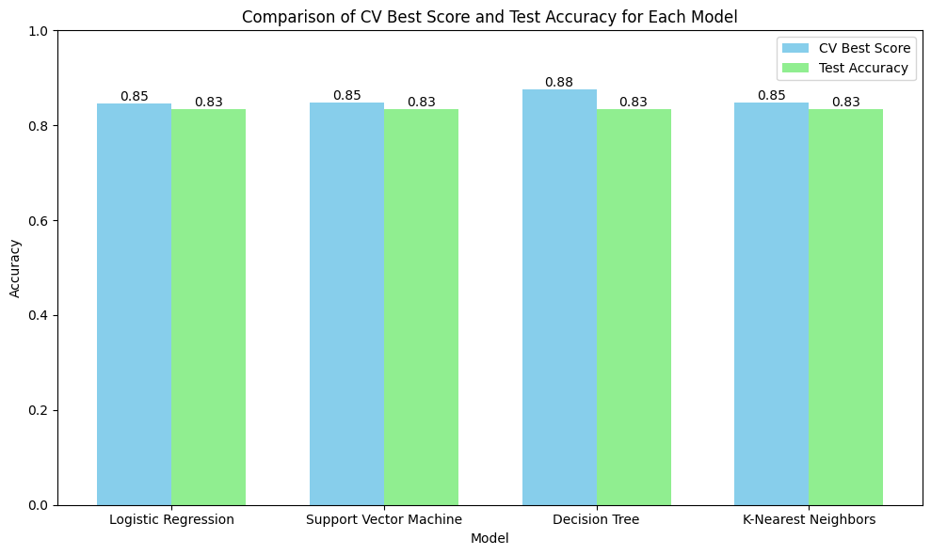
Results
Predictive analysis results:
The chart compares cross-validation (CV) performance and test accuracy across four models. All models achieved the same test accuracy (approximately 0.83), indicating similar generalization. However, the Decision Tree exhibited the highest CV Best Score (0.88), suggesting potential overfitting as its test accuracy matched the other models.

Slide 23

Section 2

Slide 24
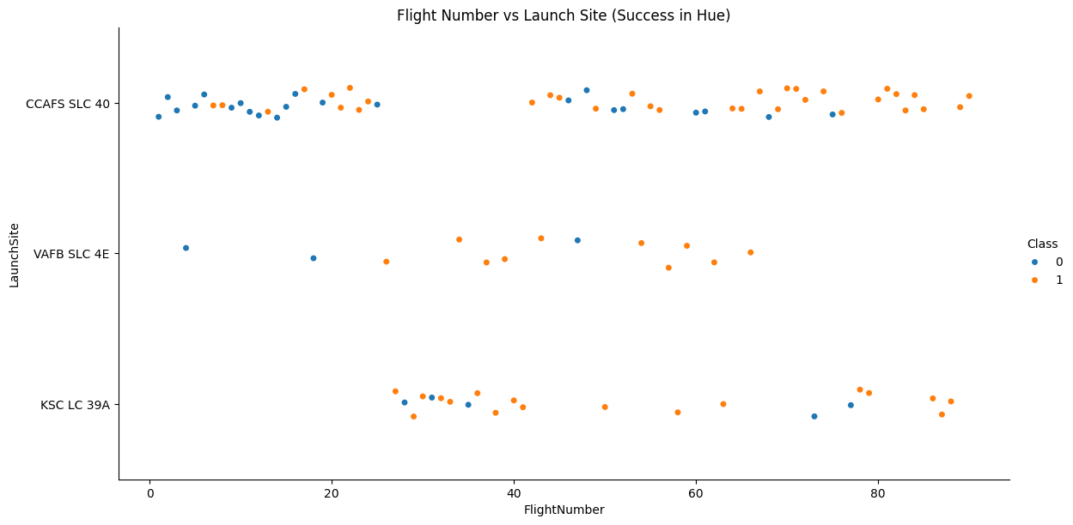
Flight Number vs. Launch Site
Key Observations:
CCAFS SLC 40:
Has a high number of launches across the full range of flight numbers.
There is a clear increase in success (more orange dots) as flight numbers increase, suggesting that reliability improved over time at this site.
KSC LC 39A:
Launches begin after a certain flight number (around flight 25).
Mostly successful launches are observed (predominantly orange), indicating strong performance at this site.
VAFB SLC 4E:
Fewer launches compared to other sites.
While early launches show mixed results, later ones tend to be more successful (more orange dots), though with less dense data.
The plot suggests that:
Success rates improved as the number of flights increased, likely due to learning and refinement.
CCAFS SLC 40 and KSC LC 39A emerged as reliable sites with increasing success.
Launch experience (flight number) and site characteristics both influence success probability.

Slide 25
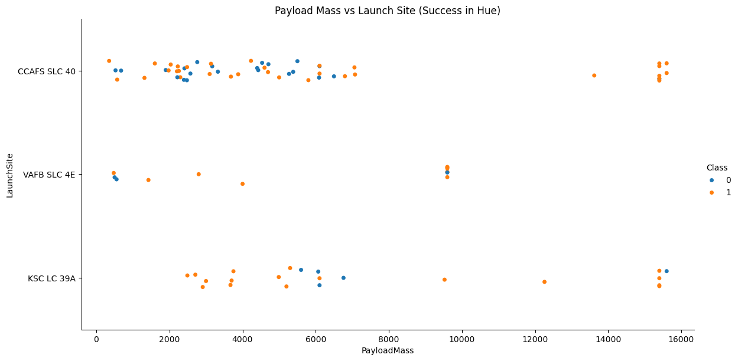
Payload vs. Launch Site
Interpretation of Payload Mass vs Launch Site Plot:
Higher payload missions were mostly successful (orange dots), especially at CCAFS SLC 40 and KSC LC 39A, indicating strong capability of these sites to handle heavier payloads.
KSC LC 39A handled many high-payload missions (>10,000 kg), with a majority resulting in success.
VAFB SLC 4E had fewer launches, mostly low to mid payloads, but still maintained a fair success rate.
There is no strong negative correlation between increasing payload and mission success — suggesting SpaceX's launch systems are robust enough to manage larger payloads without significantly affecting outcome.
The plot also supports the idea that launch site and payload capacity jointly affect success rates, with site infrastructure likely playing a role in heavier mission performance.

Slide 26
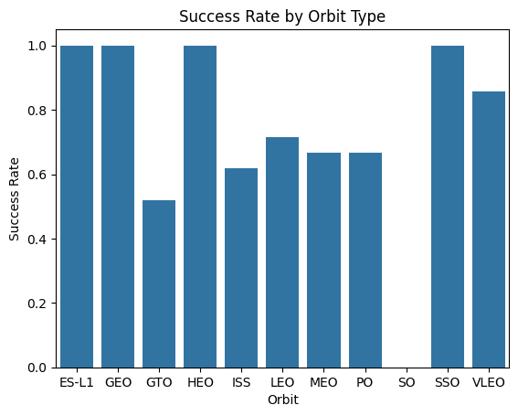
Success Rate vs. Orbit Type
Interpretation of Success Rate by Orbit Type
ES-L1, GEO, HEO, and SSO orbits show a 100% success rate, indicating highly reliable missions for these orbit types.
VLEO (Very Low Earth Orbit) also demonstrates a strong success rate, close to 90%, showing consistent performance.
GTO (Geostationary Transfer Orbit) has the lowest success rate (~50%), suggesting it might involve more technical challenges or risks during launch or landing.
MEO (Medium Earth Orbit), PO (Polar Orbit), and LEO (Low Earth Orbit) show moderate success rates, around 65–75%, implying variability depending on payload or mission type.
ISS (International Space Station) missions have slightly lower success (~63%), possibly due to strict precision requirements for docking and trajectory.
Insight:
Certain orbits demand more precision and control, potentially reducing success rates.
Orbit type clearly influences mission outcomes, and mission planning should consider risk levels tied to different orbital targets.

Slide 27
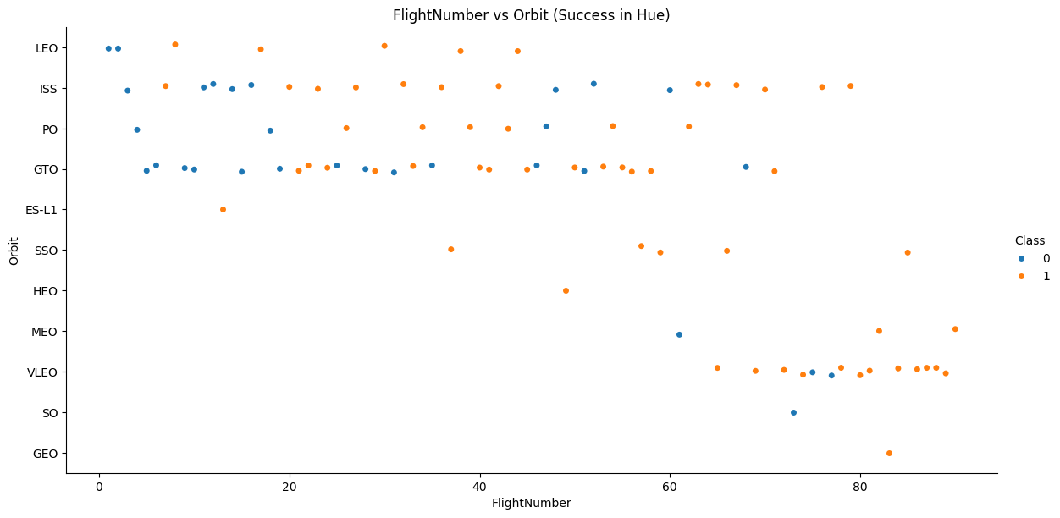
Flight Number vs. Orbit Type
Interpretation of Flight Number vs Orbit (Success in Hue)
Higher flight numbers generally show more successful launches (more orange points), indicating that experience improves mission outcomes regardless of orbit.
Orbits like LEO, ISS, and PO show successful missions across a wide range of flight numbers, suggesting consistent performance.
GTO (Geostationary Transfer Orbit) has multiple early failures (blue dots), even after many flights—confirming it’s a challenging orbit.
SSO, HEO, and GEO appear later in the flight history and are almost entirely successful, suggesting SpaceX targeted them once reliability increased.
VLEO shows a mix of successes and failures but generally improves as flight number increases.
Insight:
Mission success correlates with operational experience (flight number).
Difficult orbits (like GTO) have persistent challenges, while simpler orbits benefit more quickly from iterative improvements.
Late-stage orbit types (SSO, HEO, GEO) show near-perfect success, indicating maturity in mission execution.

Slide 28
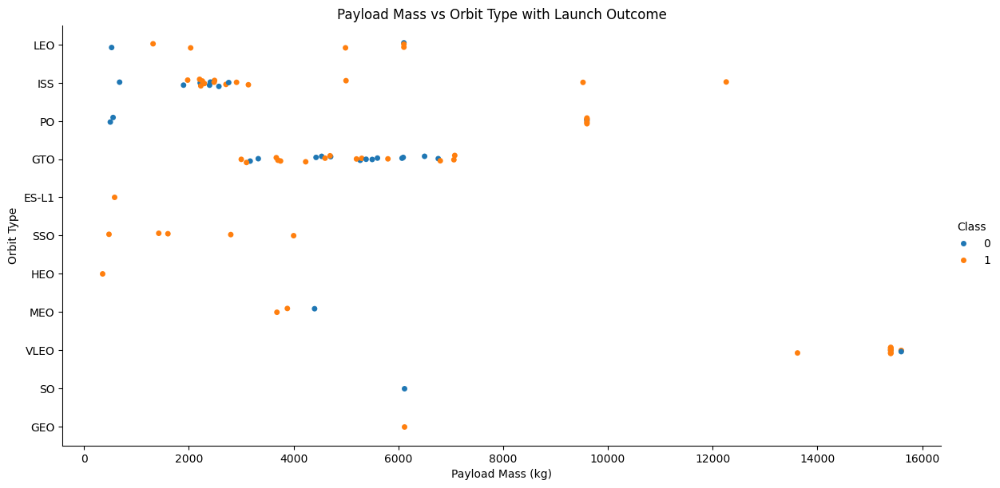
Payload vs. Orbit Type
Key Insights by Orbit:
GTO (Geostationary Transfer Orbit):
Heavier payloads (~4000–6000+ kg).
Noticeable mix of success and failure.
Suggests GTO remains challenging, especially with
heavier payloads.
ISS & LEO:
Consistently successful with light to medium
payloads (2000–6000 kg).
ISS launches are mostly successful, indicating strong
reliability.
VLEO (Very Low Earth Orbit):
Very heavy payloads (up to ~16,000 kg).
Mostly successful, but one or two failures observed.
Indicates SpaceX’s heavy lift capacity is robust, though not perfect.
PO, SSO, ES-L1:
Lighter payloads overall.
Show mostly successful missions.
These orbits have moderate difficulty but are usually reliable with lower payloads.
SO, MEO, HEO:
Fewer data points.
Occasional failure seen, but generally successful with light-to-mid payloads.
Not enough launches to generalize, but tend toward success.
GEO (Geostationary Orbit):
Only one data point (heavy failure), likely an outlier or first attempt.

Slide 29
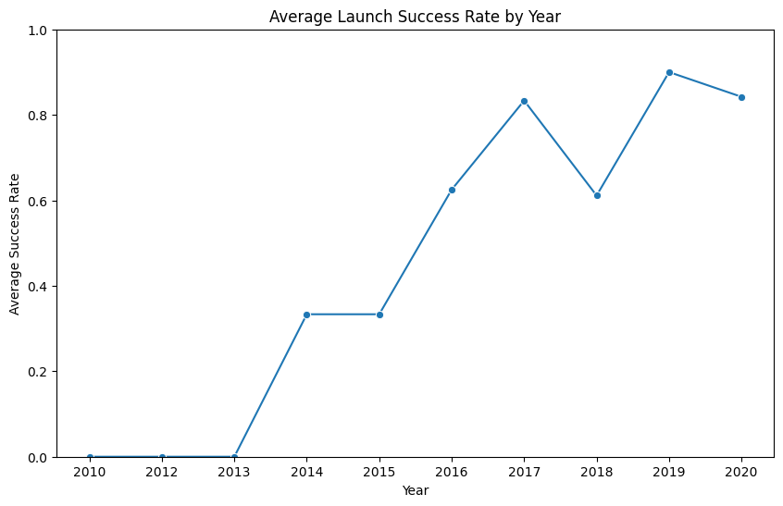
Launch Success Yearly Trend
Observations:
2010–2013:
0% success rate.
Indicates early developmental phase of SpaceX’s launches with repeated failures or no successful launches.
2014–2015:
Gradual improvement, reaching ~33% success.
Suggests growing stability and reliability in launch operations.
2016:
Jump to ~63% success rate.
Reflects significant technical and operational advancement.
2017:
~84% success rate – a breakthrough year.
SpaceX became one of the most reliable launch providers globally.
2018:
Slight dip to ~61%, likely due to a few mission anomalies or higher-risk missions.
2019:
Peak success rate at ~90%, indicating mature launch technology and process refinement.
2020:
Maintained high success rate (~84%) despite more launches and global disruptions like COVID-19.

Slide 30
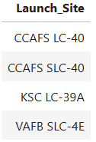
All Launch Site Names
The names of the unique launch sites
They are obtained by selecting unique occurrences of “launch_site” values from the dataset.

Slide 31
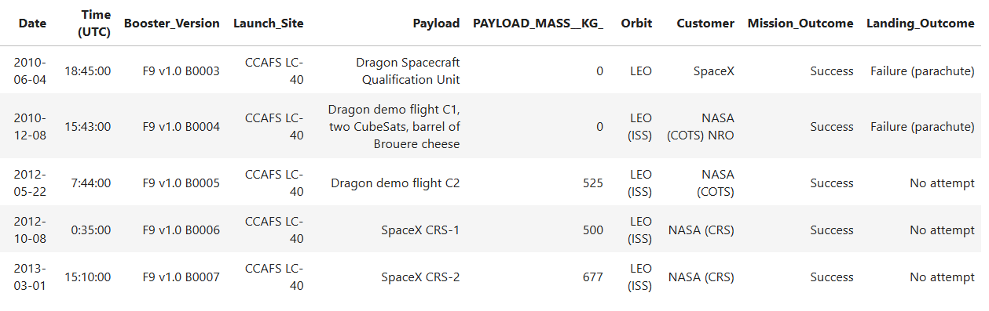
Launch Site Names Begin with 'CCA'
The 5 records where launch sites begin with `CCA`
As we can see, they are five samples of Cape Canaveral launches.

Slide 32
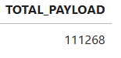
Total Payload Mass
The total payload carried by boosters from NASA
This aggregate payload mass of 111,268 units (assuming the units are consistent, e.g., kg) represents the total mass delivered to orbit under NASA's CRS missions within the dataset considered. This aggregated metric provides a high-level overview of the logistical throughput achieved through this specific category of spaceflight activities.

Slide 33
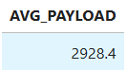
Average Payload Mass by F9 v1.1
The average payload mass carried by booster version F9 v1.1
The average payload mass transported by the Falcon 9 booster version v1.1 is approximately 2928.4 kg.
This value represents the arithmetic mean of the payload masses for all launches that utilized the F9 v1.1 booster. It provides a central tendency for the payload capacity demonstrated by this specific iteration of the Falcon 9.

Slide 34
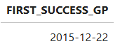
First Successful Ground Landing Date
Find the dates of the first successful landing outcome on ground pad
The successful ground pad landing on December 22, 2015, represents a pivotal moment in the advancement of reusable rocket technology. Prior to this, while there were attempts at controlled landings, achieving a stable and successful touchdown on a designated ground site demonstrated a significant leap in precision and reliability.

Slide 35
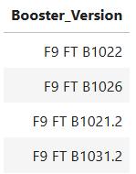
Successful Drone Ship Landing with Payload between 4000 and 6000
List of the names of boosters which have successfully landed on drone ship and had payload mass greater than 4000 but less than 6000
This selection highlights specific booster performances that fall within a defined payload capability range while also demonstrating successful autonomous landing on an offshore platform. This is indicative of a mature stage in reusable launch technology, where specific payload requirements can be met with a high degree of recovery success on drone ships.

Slide 36
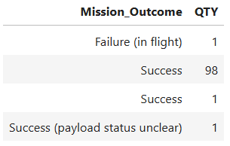
Total Number of Successful and Failure Mission Outcomes
Calculate the total number of successful and failure mission outcomes
The dataset contains a total of 100 successful mission outcomes and 1 failure (in flight). This indicates a very high success rate for the missions included in this data. The majority of the successful missions are categorized simply as "Success", with a smaller number where the payload status was unclear but the mission was otherwise a success. The single "Failure (in flight)" stands out, highlighting the inherent risks associated with space launches, even within a generally successful program.

Slide 37
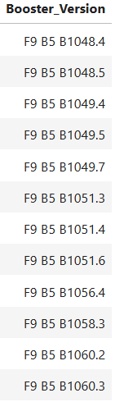
Boosters Carried Maximum Payload
List the names of the booster which have carried the maximum payload mass
The insight is that the booster versions listed (F9 B5 B1048.4, F9 B5 B1048.5, F9 B5 B1049.4, F9 B5 B1049.5, F9 B5 B1049.7, F9 B5 B1051.3, F9 B5 B1051.4, F9 B5 B1051.6, F9 B5 B1056.4, F9 B5 B1058.3, F9 B5 B1060.2, F9 B5 B1060.3) are the ones that have carried the maximum payload mass within the dataset.
This implies that these specific iterations of the Falcon 9 Block 5 booster have demonstrated the highest capacity for lifting cargo into orbit among all the launches recorded. It's important to note that "maximum" here is relative to the data available.

Slide 38
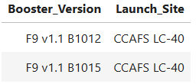
2015 Launch Records
List of the failed landing_outcomes in drone ship, their booster versions, and launch site names for in year 2015
In the year 2015, there were at least two recorded instances of failed landing outcomes on a drone ship:
Booster Version: F9 v1.1 B1012, launched from Launch Site: CCAFS LC-40.
Booster Version: F9 v1.1 B1015, launched from Launch Site: CCAFS LC-40.
This highlights the early challenges in achieving reliable autonomous landings on moving platforms at sea. The fact that both failures involved the F9 v1.1 booster version and originated from the same launch site might suggest areas of focus for early engineering improvements.

Slide 39
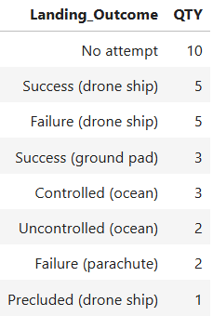
Rank Landing Outcomes Between 2010-06-04 and 2017-03-20
Ranking of the count of landing outcomes (such as Failure (drone ship) or Success (ground pad)) between the date 2010-06-04 and 2017-03-20, in descending order
Failure (drone ship): 5
Success (ground pad): 3
The other landing outcomes listed ("No attempt", "Success (drone ship)", "Controlled (ocean)", "Uncontrolled (ocean)", "Failure (parachute)", "Precluded (drone ship)") are not the specific ones requested for ranking in the first image.
Insight:
Between June 4, 2015, and March 20, 2017, the most frequent of the specified landing outcomes was "Failure (drone ship)", occurring 5 times. Following this, "Success (ground pad)" occurred 3 times. This ranking provides a direct comparison of the frequency of these two types of landing outcomes during that specific period, indicating that drone ship landing failures were more common than ground pad landing successes within that timeframe.

Slide 40

Section 3

Slide 41
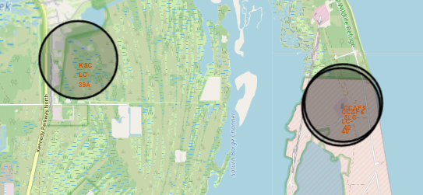
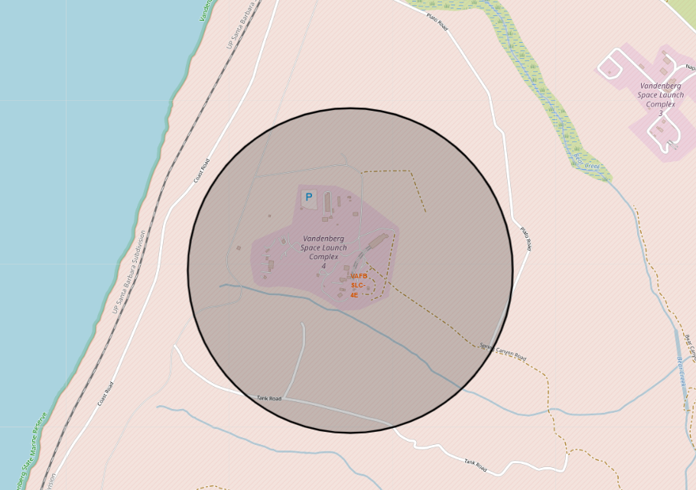
All Launch Sites’ Location Markers on a Global Map

Slide 42
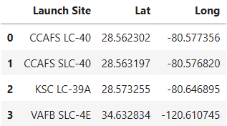
All Launch Sites’ Location Markers on a Global Map
These are the All Four Launch Sites with their Latitude and Longitude
And we can see in slide 41, that all sites are marked on Global-Map

Slide 43
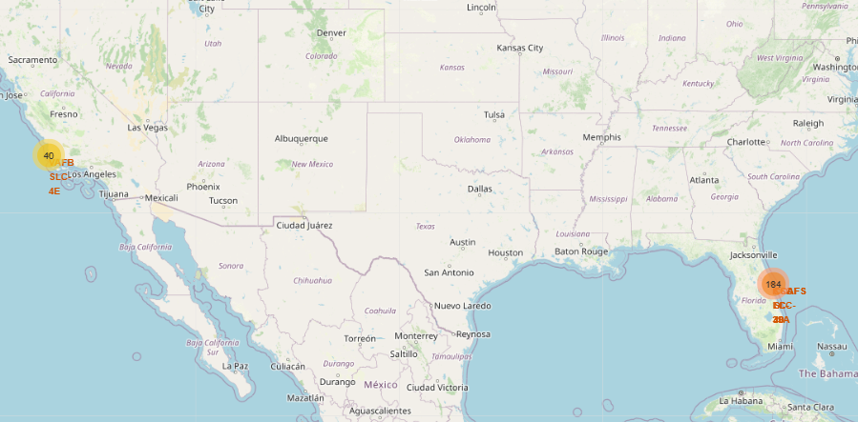
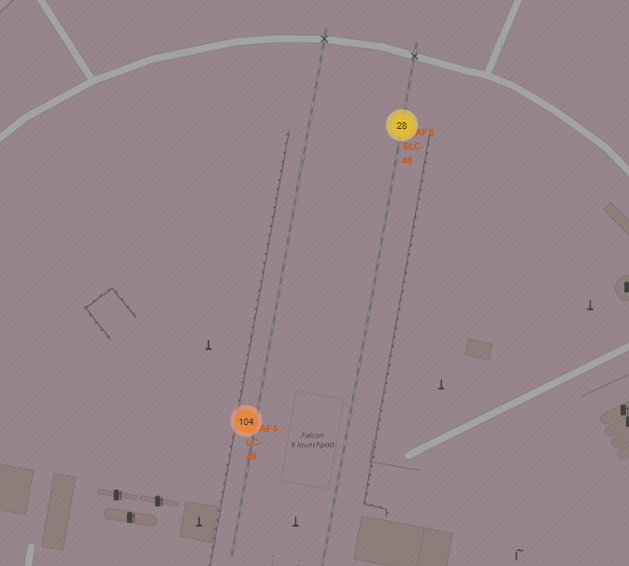
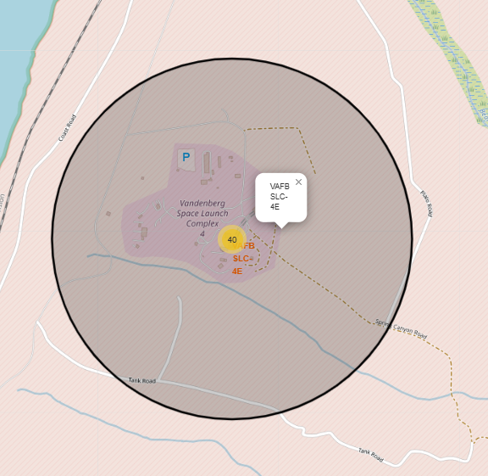
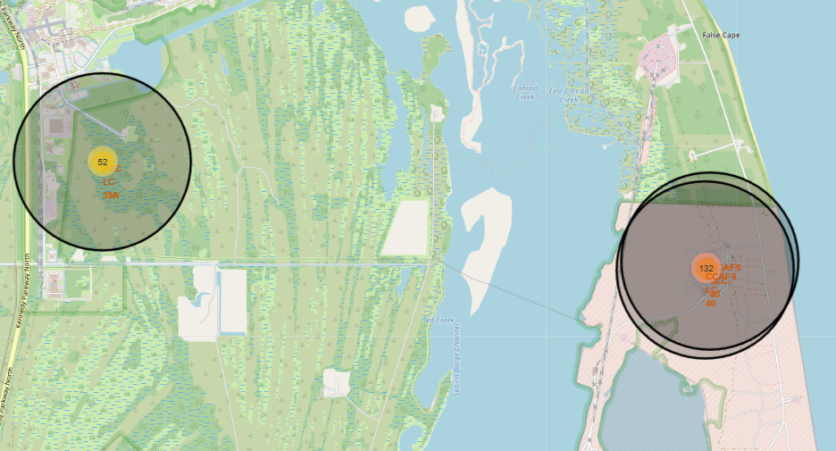
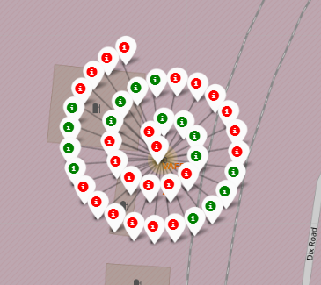
The Color-Labeled Launch on the Map

Slide 44
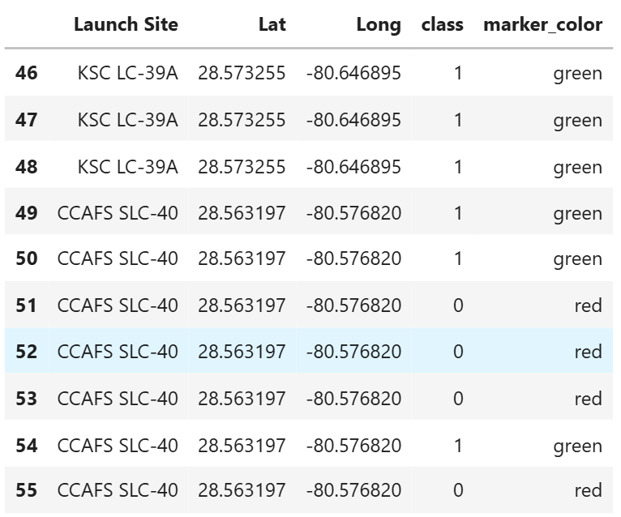
The Color-Labeled Launch on the Map
Green markers indicate successful and red ones indicate failure.

Slide 45
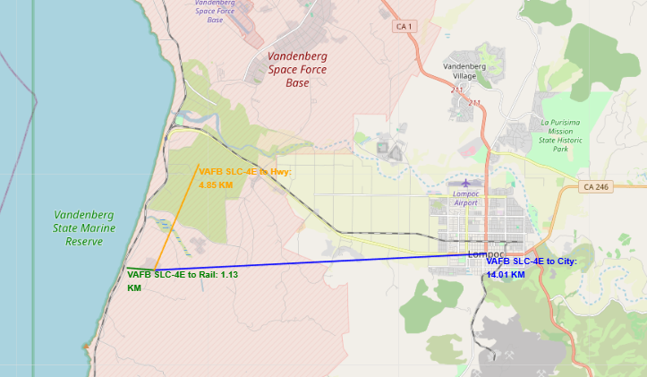
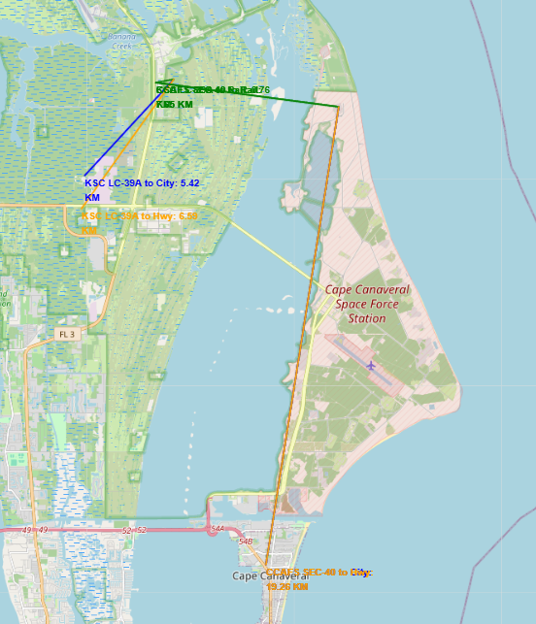
Distances between Railway, Highway, Coastline

Slide 46
Distances between Railway, Highway, Coastline
Image 1: Cape Canaveral Space Force Station (Florida)
KSC LC-39A to City: A blue line indicates this route with a distance of 5.42 KM. The "City" in this context likely refers to a nearby urban area, possibly Titusville or a part of Cape Canaveral.
CCAFS SLC-40 to City: An orange line shows this route with a distance of 10.26 KM. Similar to the above, the "City" here is a nearby urban area.
There's also a green line segment with "5.66 KM" and a yellow line segment with "5.38 KM" originating from the CCAFS area, but their destinations aren't explicitly labeled as "City" in the same way.
Image 2: Vandenberg Space Force Base (California)
VAFB SLC-4E to Hwy: An orange line indicates a distance of 4.85 KM to a highway.
VAFB SLC-4E to Rail: A green line shows a short distance of 1.13 KM to a railway line.
VAFB SLC-4E to City: A blue line indicates a distance of 14.01 KM to the city, which is likely Lompoc based on the map context.

Slide 47

Section 4

Slide 48
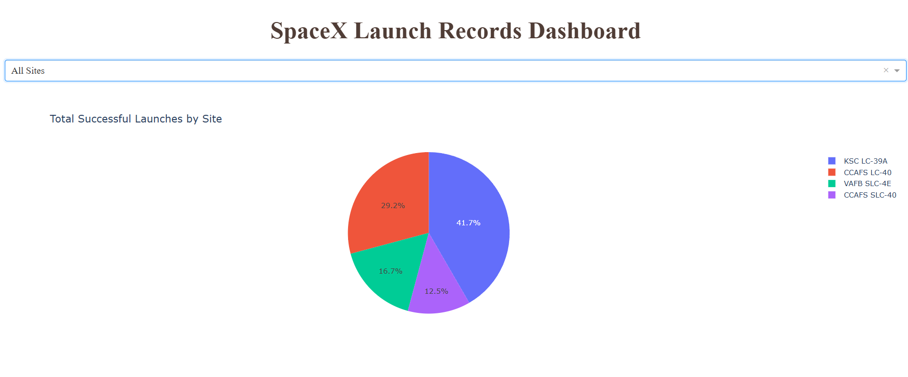
Launch Success Count
Total Successful Launches by Site: The pie chart shows the distribution of total successful launches across different launch sites.

Slide 49
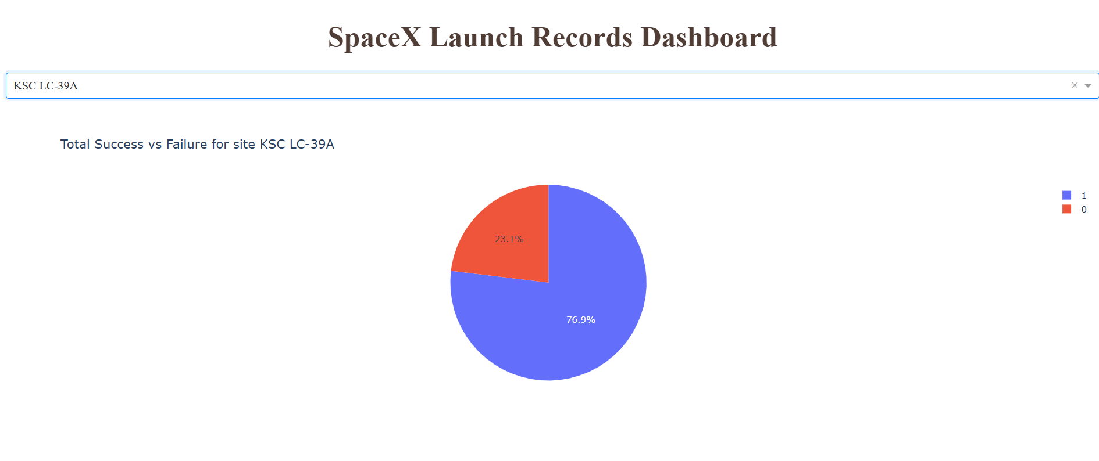
Highest Launch Success Ratio
High Success Rate at KSC LC-39A: When focusing specifically on the KSC LC-39A launch site, the pie chart shows a significantly high success rate of 76.9% (represented by the blue portion labeled '1'). This indicates that while KSC LC-39A has the highest number of successful launches overall, it also demonstrates a strong track record of successful launches relative to the number of attempts from this site.

Slide 50
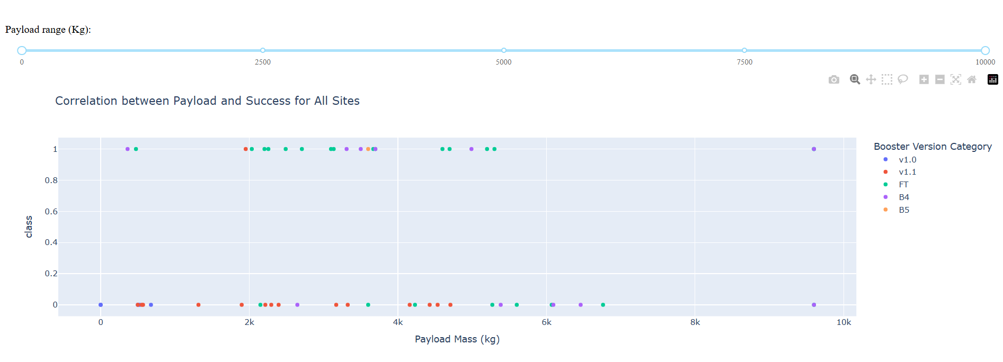
Payload vs. Launch Outcome
Payload range approximately 0-10000 kg:
We see a wider distribution of payload masses, from very low to around 10,000 kg.
There are successful launches across a broad range of payload masses.
Failures seem to be concentrated at lower payload masses, although there are some failures at higher masses as well.
The booster version 'v1.0' (blue) appears only in the lower payload range and mostly corresponds to failures.

Slide 51
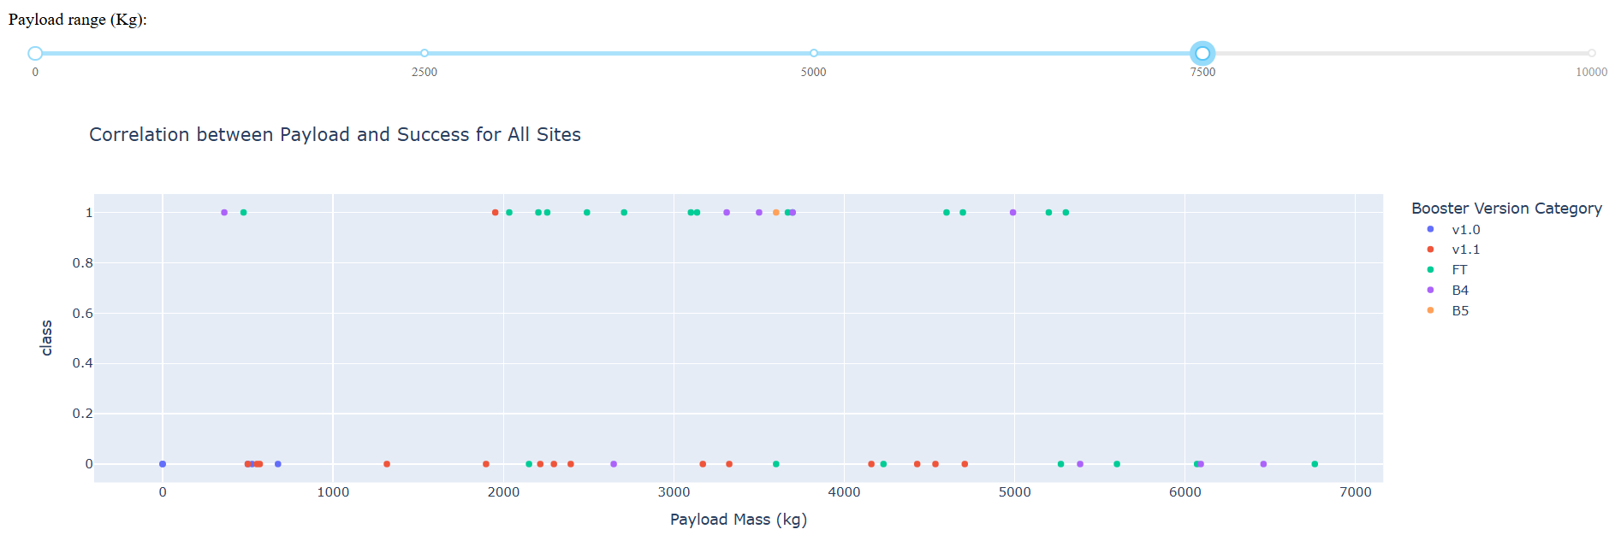
Payload vs. Launch Outcome
Payload range approximately 0-7000 kg:
This plot focuses on the lower to mid-range of payload masses.
We can more clearly see the distribution of successes and failures within this range.
It still seems that successful launches are prevalent.
Different booster versions (green, purple, orange, red) show successes within this payload range.

Slide 52

Section 5

Slide 53
Classification Accuracy
Insights from the Chart:
Logistic Regression: The CV Best Score is 0.85, and the Test Accuracy is 0.83. The model seems to generalize reasonably well, with a slight dip in performance on the test set.
Support Vector Machine: Similar to Logistic Regression, the CV Best Score is 0.85, and the Test Accuracy is 0.83. It also shows good generalization.
Decision Tree: This model has the highest CV Best Score at 0.88, but its Test Accuracy is also 0.83. The larger difference between the CV score and the test accuracy could suggest a bit more overfitting compared to the linear models, although the test accuracy is still comparable.
K-Nearest Neighbors: The CV Best Score is 0.85, and the Test Accuracy is 0.83, again showing consistent generalization similar to Logistic Regression and SVM.

Slide 54
Confusion Matrix
Insights:
As we've discussed, all four models (Logistic Regression, SVM, Decision Tree, and KNN) achieved the exact same test accuracy. This means there isn't a single 'best' model based purely on accuracy.
To proceed with generating a confusion matrix, we still need to select one of these equally accurate models. Which model would you like to see the confusion matrix for? For instance, we could choose:
The Logistic Regression model (as it was the first identified as 'best' by the code).
The Decision Tree model (which had the highest cross-validation score).
Any of the models, since their test accuracy is identical."

Slide 55
Conclusions
A comprehensive dataset was created by combining SpaceX API data, web scraping, and data wrangling techniques, ensuring the quality and relevance of the collected information.
Exploratory Data Analysis (EDA) was performed using SQL queries and interactive visualizations, enabling deep insights into mission characteristics and patterns.
The launch site KSC LC-39A emerged as the most successful and reliable location for launches.
Launches carrying payloads above 7,000 kg demonstrated a higher likelihood of mission and landing success, indicating lower operational risk at higher payload ranges.
Despite early challenges, landing success rates have consistently improved over time, showcasing the technological and procedural advancements made by SpaceX.
Through machine learning classification models, particularly the Decision Tree Classifier, we were able to predict successful landings using historical mission data. This supports data-driven decision-making to optimize launch conditions and maximize profitability.

Slide 56
Appendix
Well, any explicit content was not created by me at all.
But I did all the tasks inside all the labs.
I’ve gathered screenshots and all that were important, I’ll list all in repository as well.

Slide 57


